Slide 1
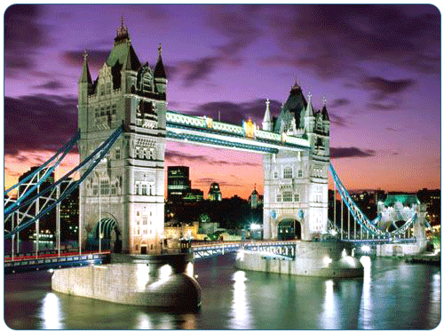


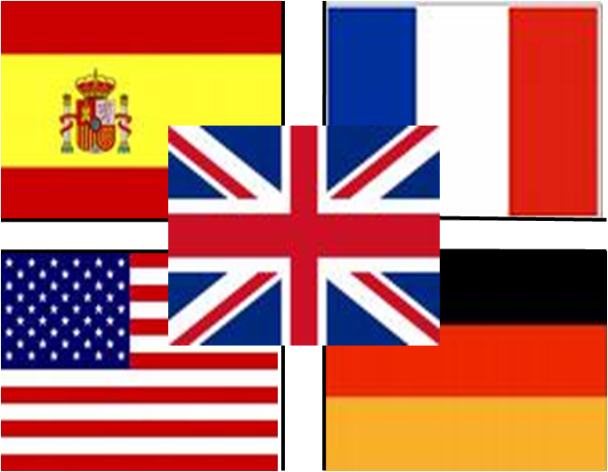
London
Welcome To London

Slide 2
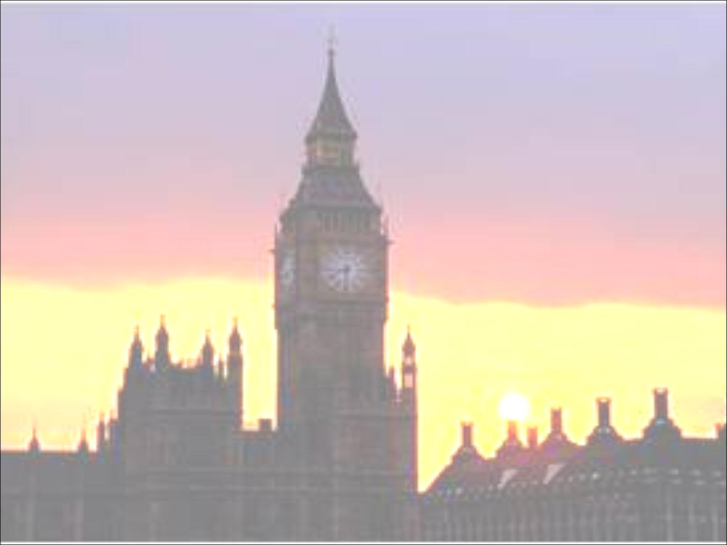
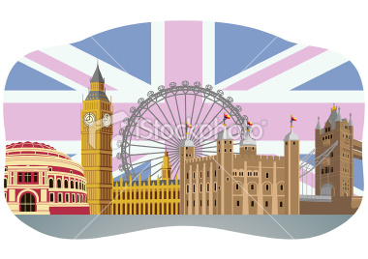
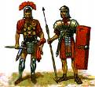
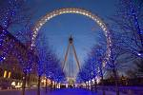
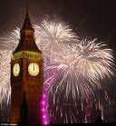
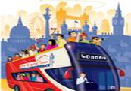
London
London is the capital of England and the united kingdom
Its history goes back to its founding by the Romans, who called it Londinium
It is the most popular place in entire Europe. The big Ben, London bridge, London eye are just some of the most famous places in the whole of London.

Slide 3
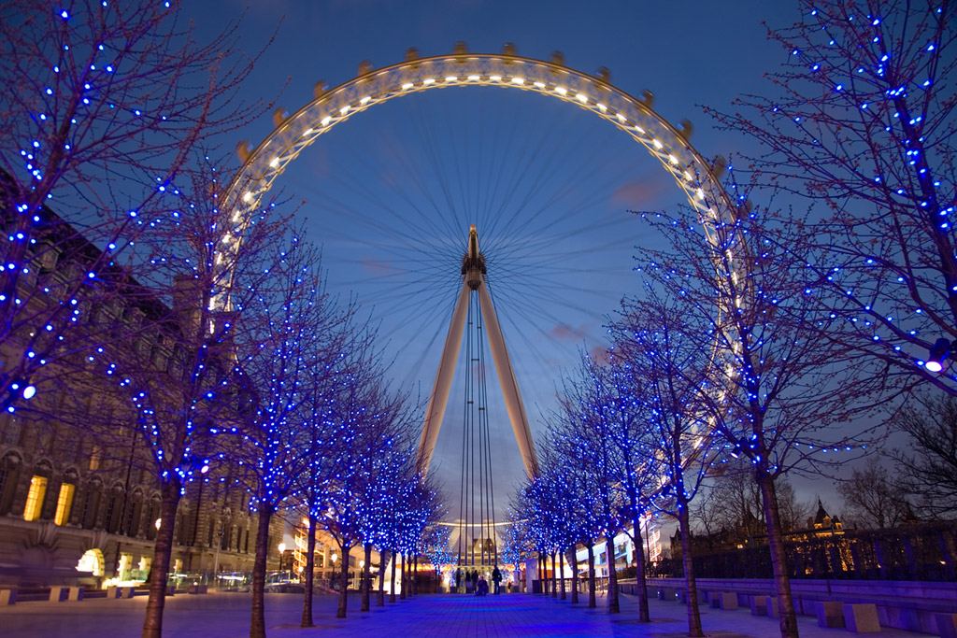
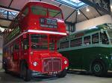
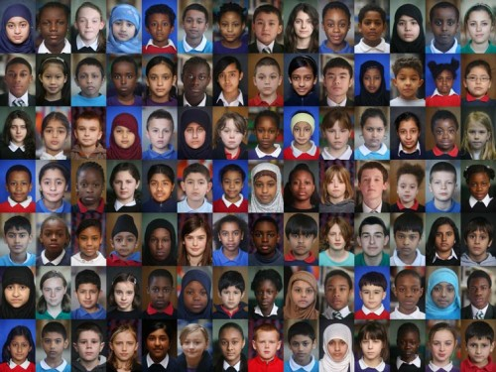


London
In London there are a verity of different ways to travel such as the buses, the taxi, as well as there are ferries which take you from one city to another by sea. There are also river cruises which are totally free in London
London has a diverse range of peoples, cultures, religions, and more than 300 languages are spoken within its boundaries.
London's influence in politics, finance, education, entertainment, media, fashion, the arts and culture in general contributes to its global position.

Slide 4
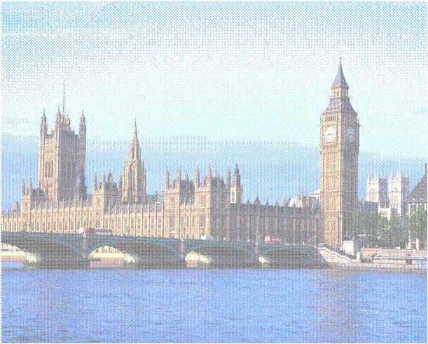
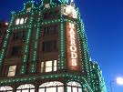

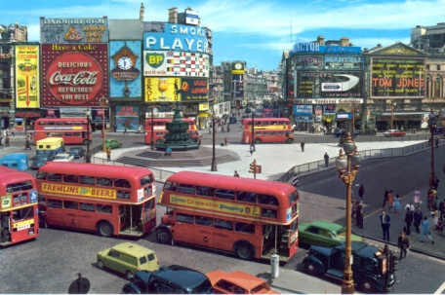
London
London is well known and famous for it shopping centers and for its famous shops. Below are some of the shops which London is well known for;
Oxford street: In the heart of central London’s busiest shopping district lies Oxford Street.
Piccadilly Circus: One of London’s best-known and most popular tourist attractions is Portobello market, famed for it’s antiques and second-hand bargains.
Harrods:Harrods is one of the world’s most famous department stores. Its motto is"Omnia Omnibus Oblique", which means "All Things, For All People, Everywhere".

